Slide 1
Genetic Algorithms and XO Skin
AI systems for questionnaire-based product recommendation

Slide 2
What are genetic algorithms?
Family of computer algorithms (digital recipes) with roots on ai research
First proposed and studied by computer scientist john Henry holland in the mid-1970's (university of Michigan, Ann arbor)
They're based on how biological organisms favor genetical changes that make them more fit
Good for solving problems that aren't easily modelled by yes/no questions
Used nowadays in automotive design, telecommunications, shipment routing, finance and investment strategies, marketing and merchandising

Slide 3
Why genetic algorithms and XO Skin?
XO Skin plans to recommend products based on the customer's skin type and climate among other factors
Hard-coded (e.g. lookup-table) based solutions will not scale (data entry and hard-coding becomes intractable (undoable) as the list of products increases)
Product recommendation formulation is amenable (well-adapted) to a genetic algorithm (AI) solution approach
I specialized in the study of such algorithms in college and have written and published a framework (API) for applying such algorithms to general problems
I wrote a specialized library using this api (adaptive computing framework) to solve the product recommendation problem for xo skin
Because it's cool and gives us "ai-cred" (increasing brand marketability) ("Got AI?")

Slide 4
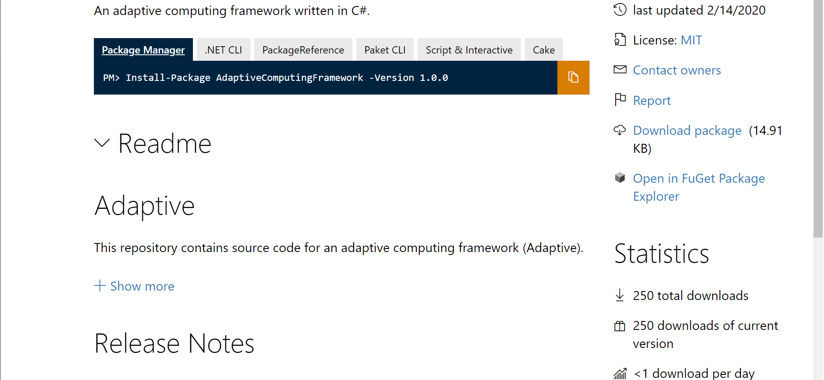
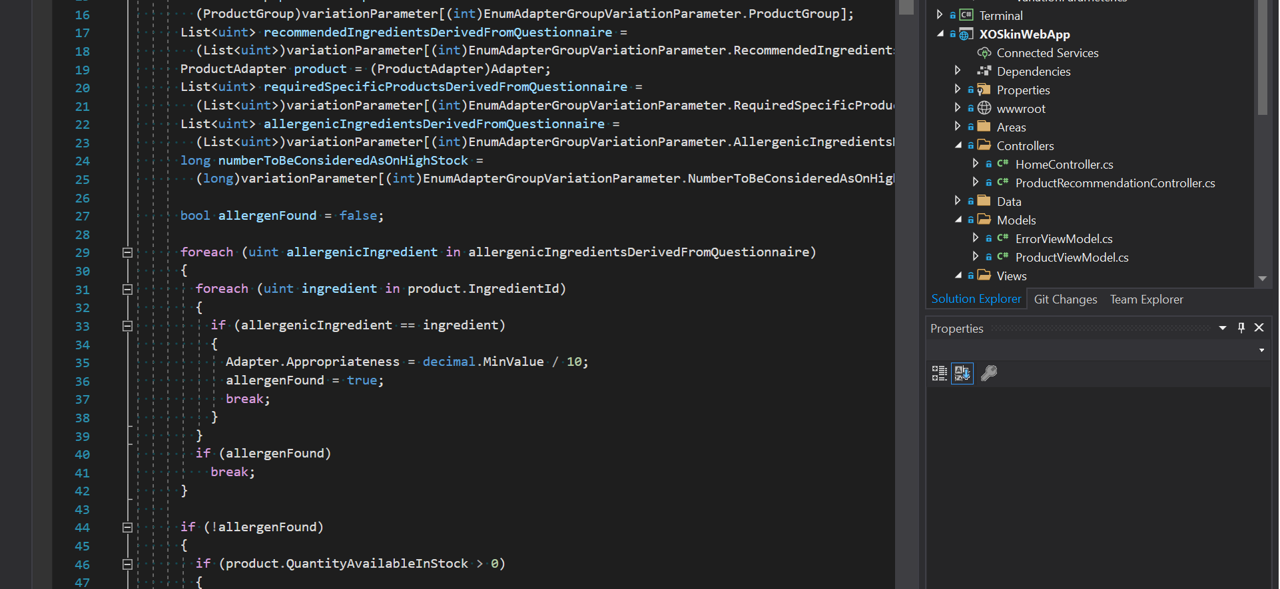
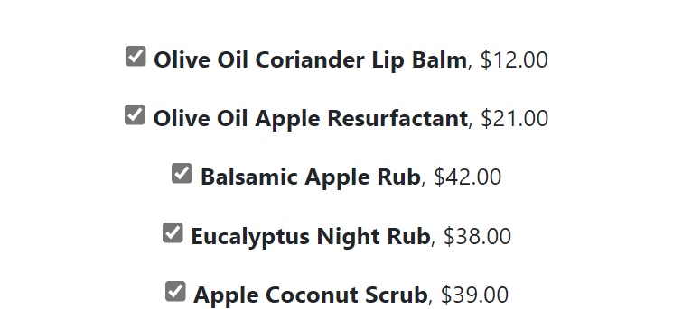
Why genetic algorithms and xo skin?
Adaptive computing framework
Adapted to xo skin
Integrated into Xo Skin web application
Available on nuget.org written and published by the presentation's author
Code written, tested and debugged to integrate the GA API with XO Skin's product recommendation challenge
Code has been written tested and debugged and is already integrated into the XO Skin Web application

Slide 5
Tech-DEMO
(please stand-by)

Slide 6
What to do next?
Short Term
SME (Subject matter expert): please complete "Collaborative SWOT Analysis Matrix, XO Skin Corp.xlsx" with information requested and limited to our launch products.
Medium-long term
SME (subject matter expert): come up with additional ideas for algorithm data points (criteria that algorithm should use to make good recommendations.)

Slide 7
Reference
Genetic algorithms: Computer programs that "evolve" in ways that resemble natural selection can solve complex problems even their creators do not fully understand (john henry holland) https://www.cc.gatech.edu/~turk/bio_sim/articles/genetic_algorithm.pdf
NUget gallery: adaptive computing framework (Rafael Pérez) https://www.nuget.org/packages/adaptivecomputingframework/
XO skin web application code (XO SKIN, CORP., q8 worldwide) https://dev.azure.com/knightsofavalon/_git/XO/commits

Slide 8
Questions?

